Slide 1


Robotics Workshop Week 6 Gears and Motion, Motorized
Notes:
Hello everyone and welcome to the 6th robotics workshop.
In todays worksheet we will be building apon what you have learnt in a previous worksheet in week 3: “Gears and motion” where you assembled a mechanical turret. This time youll be rebuilding that turret and adding stepper motors to so it can move by its own power.

Slide 2
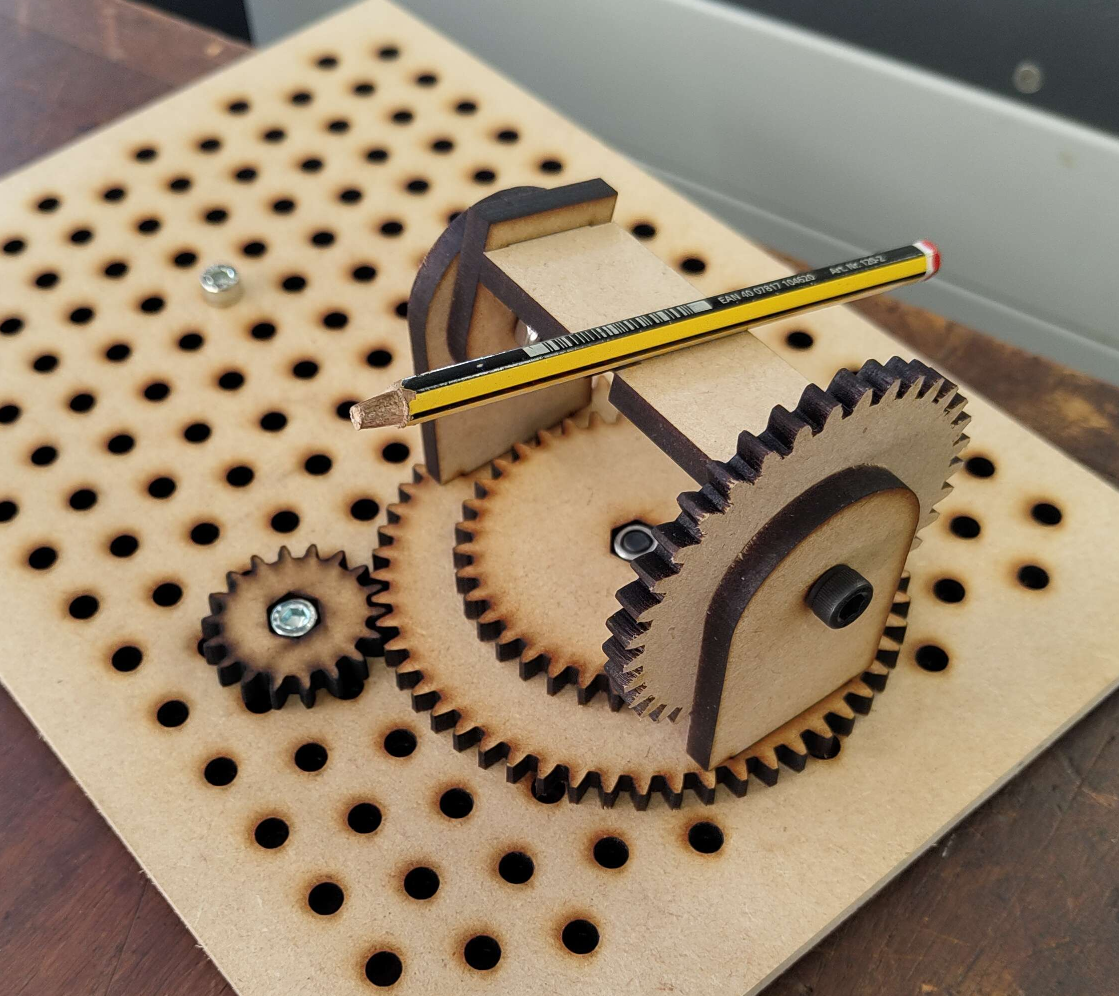
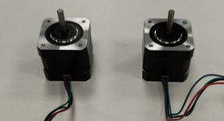
Follow the worksheet, combine these!
Notes:
Lets get started.

